Slide 1

LCD
1

Slide 2
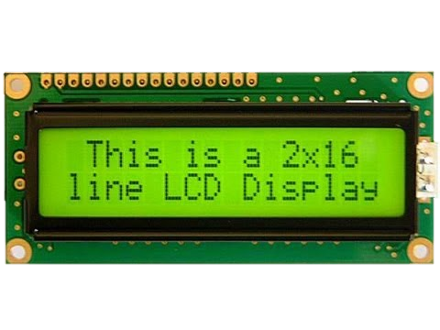
How does the LCD work?
Configuration and initialization stage.
Write the data to be displayed.

Slide 3
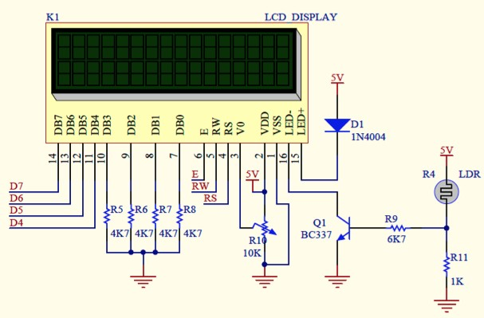
Pinout

Slide 4
Steps
For each data or instruction:
Set R/!W and RS with the desired value
Wait > 60 ns.
Set Enable to 1.
Wait > 230 ns.
Place the bits DB7..DB4.
Wait > 230 ns.
Clear the Enable.
RS | R/!W | Operation
0 | 0 | To write instructions to the LCD
0 | 1 | To read the Busy flag (DB7)
1 | 0 | To write our data to the LCD

Slide 5
Writing a 4-bits instruction:
60 ns
500 ns
500 ns
R/!W
RS E DB7 DB6 DB5 DB4
230 ns valid data
Conﬁgure DB[7..4] as input
RS | R/!W | DB7 | DB6 | DB5 | DB4
0 | 0 | 0 | 0 | 1 | 1

Slide 6
Writing a 4+4 bits instruction:
60 ns
500 ns
500 ns
500 ns
500 ns
R/!W
RS E DB7 DB6 DB5 DB4
230 ns valid data
230 ns valid data
Send the 4 MSB
Send the 4 LSB
Configure DB[7..4] as input
RS | R/!W | DB7 | DB6 | DB5 | DB4
0 | 0 | 0 | 0 | 1 | 1
RS | R/!W | DB7 | DB6 | DB5 | DB4
0 | 0 | 0 | 1 | 1 | 1

Slide 7
Initialization stage
Instructions on page 24 of the Hitachi HD44780U datasheet

Slide 8







Power the display* *The first line of the display is painted black.
Wait > 100 ms
RS | R/!W | DB7 | DB6 | DB5 | DB4
0 | 0 | 0 | 0 | 1 | 1
Wait > 4,1ms
RS | R/!W | DB7 |  | DB6 | DB5 | DB4
0 | 0 | 0 |  | 0 | 1 | 1
Wait > 100 us
RS | R/!W | DB7 | DB6 | DB5 | DB4
0 | 0 | 0 | 0 | 1 | 1
Wait > 100 us

Slide 9



Wait > 100 us
RS | R/!W | DB7 |  | DB6 | DB5 | DB4
0 | 0 | 0 |  | 0 | 1 | 0
From this moment, we are in 4-bits mode.
When we activate the Enable, the LCD will get the Highest part of the instruction from DB[7..4] and will store it. Then, when we activate the Enable again the LCD will get the Lowest part of the instruction, will generate the 8- bits complete instruction and will execute it.

Slide 10



Wait > 53 us or until BUSY(DB7) bit is 0.
RS | R/!W | DB7 | DB6 | DB5 | DB4
0 | 0 | 0 | 0 | 1 | 0
RS | R/!W | DB7 |  | DB6 | DB5 | DB4
0 | 0 | N |  | F | * | *
N = Number of logical rows. In our case, N = 1.
F = Resolution of each character. We will clear this bit because we want dimensions of 5x7.

Slide 11
Wait > 53 us or until the BUSY(DB7) bit is 0.
RS | R/!W | DB7 | DB6 | DB5 | DB4
0 | 0 | 0 | 0 | 0 | 0
RS | R/!W | DB7 |  | DB6 | DB5 | DB4
0 | 0 | 1 |  | 0 | 0 | 0
From this moment, the first row of the LCD is cleared (turned off).
Display On/Off control-> in this case, we set it to OFF to initialize it (DB7 = 1 and DB6= 0).

Slide 12
Wait > 3 ms or until the BUSY(DB7) bit is 0.
RS | R/!W | DB7 | DB6 | DB5 | DB4
0 | 0 | 0 | 0 | 0 | 0
RS | R/!W | DB7 |  | DB6 | DB5 | DB4
0 | 0 | 0 |  | 0 | 0 | 1
“Clear Display” Instruction.
Even when respecting all the indications of the datasheet, in some displays a wait of 3ms is necessary independently of the busy bit.

Slide 13

Wait > 53 us or until the BUSY(DB7) bit is 0.
RS | R/!W | DB7 |  | DB6 | DB5 | DB4
0 | 0 | 0 |  | 0 | 0 | 0
RS | R/!W | DB7 |  | DB6 | DB5 | DB4
0 | 0 | 0 |  | 1 | I/D | S
This instruction determines how the cursor will move.
To move from left to right (normal movement of the cursor) I/D=1.
S is used to shift. Usually, S=0.

Slide 14




End of initialization
RS | R/!W | DB7 | DB6 | DB5 | DB4
0 | 0 | 0 | 0 | 0 | 0
RS | R/!W | DB7 |  | DB6 | DB5 | DB4
0 | 0 | 1 |  | 1 | C | B
Wait > 53 us or until the BUSY(DB7) bit is 0.
Turn on the display (DB6=1).
C is used to make the cursor visible (C=1) or invisible (C=0).
B is the blinking bit. If B=1 Blinking is ON.
Repeat all the initialization process 3 times.

Slide 15
Display characters using
the LCD

Slide 16


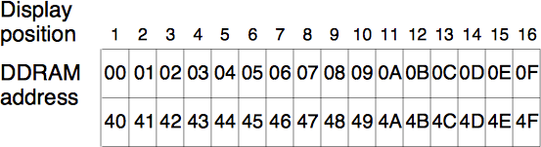
Step 1: Select the position of the cursor
(instruction)
Wait until the BUSY(DB7) bit is 0.
RS | R/!W | DB7 |  | DB6 | DB5 | DB4
0 | 0 | 1 |  | @DDRAM | @DDRAM | @DDRAM
RS | R/!W | DB7 | DB6 | DB5 | DB4
0 | 0 | @DDRAM | @DDRAM | @DDRAM | @DDRAM

Slide 17


Step 2: Write an ASCII character to the LCD.
(data)
Wait until the Busy (DB7) bit is 0.
RS | R/!W | DB7 |  | DB6 | DB5 | DB4
1 | 0 | ASCII [7] |  | ASCII [6] | ASCII [5] | ASCII [4]
RS | R/!W | DB7 | DB6 | DB5 | DB4
1 | 0 | ASCII [3] | ASCII [2] | ASCII [1] | ASCII [0]

Slide 18
Extra information
Datasheet Hitachi HD4478U:
Page. 24: Instructions of the LCD.
Page. 12: Relation between the address of the DDRAM and the position of the cursor.
Page. 58: Timing diagrams.

